Slide 1

Wireless Settings
SSID: pegstaff
Security mode: WSA-Personal
Password: letmeinplease!
Google Group
http://group.stlalt.net

Slide 2
Reminder
Next month is our annual
social event!
Location TBD
Swag will be raffled!

Slide 3
CQRS and Event Sourcing
With NCQRS
Nicholas Cloud

Slide 4
CQRS
Command/Query Responsibility Segregation
Commands == Writes
Queries == Reads

Slide 5
CQRS
In a stateless application (or in a cached application), data is “stale” as soon as it is retrieved from the database
“Reads” are, by far, the most common data operation in a typical application
“Reads” and “writes” are performed against different data stores

Slide 6
CQRS
Commands modify the domain layer; they change domain state
Queries only fetch data; they are side-effect free
The “read” data store does not contain a normalized database, but instead contains “views” of data that are easy to query (eliminating joins)

Slide 7
CQRS
The domain model is only necessary for handling commands; it is unnecessary for queries
Data retrieval (queries) need not be transformed into domain objects, if all domain logic occurred prior to persistence
ORMs are good, but the tend to blur the line between the domain and data access layers

Slide 8
Event Sourcing
Stale data causes concurrency problems that have to be dealt with
Tom accesses Record 1
Beth accesses Record 1
Beth updates Record 1
Tom updates Record 1
Beth’s changes are lost
Without an audit log, there is no way to know about state changes

Slide 9
Event Sourcing
Common database implementations only provide a snapshot of the current state of the domain
ES records all state changes to the domain
Accounting analogy: accountants never erase numbers from a ledger, they always create offsetting entries – they do not work with “current state”

Slide 10
Event Sourcing
By recording all state changes to the domain as a series of events, domain changes can be replayed to recreate current state at any time
If a bug exists in the domain, a record of state changes can help identify where it occurred
Because current state is built from known history, current state is always correct

Slide 11
Event Sourcing
Raw event data is persisted in its own data store
An event bus pipes domain state change events to objects that populate the “read” data store
The difference in time between these two operations means that data is eventually consistent…

Slide 12
Event Sourcing
…but eventual consistency is ok, because most systems deal with stale data anyway
This means that layers within an application can interact asynchronously, because there is no need to block for data to become consistent

Slide 13
Key Concepts
There are drastic differences between “reads” and “writes”, and a system should reflect this
The domain model should be decoupled from the data store
A single model is not appropriate for all circumstances (transactions, reporting, searching, etc.)

Slide 14
Key Concepts
State changes are important, and should be modeled and recorded
Relaxed consistency is fine – most business cases have no need of immediate consistency

Slide 15
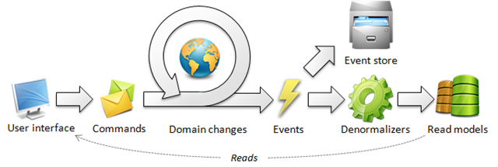
ncqrs.org

Slide 16
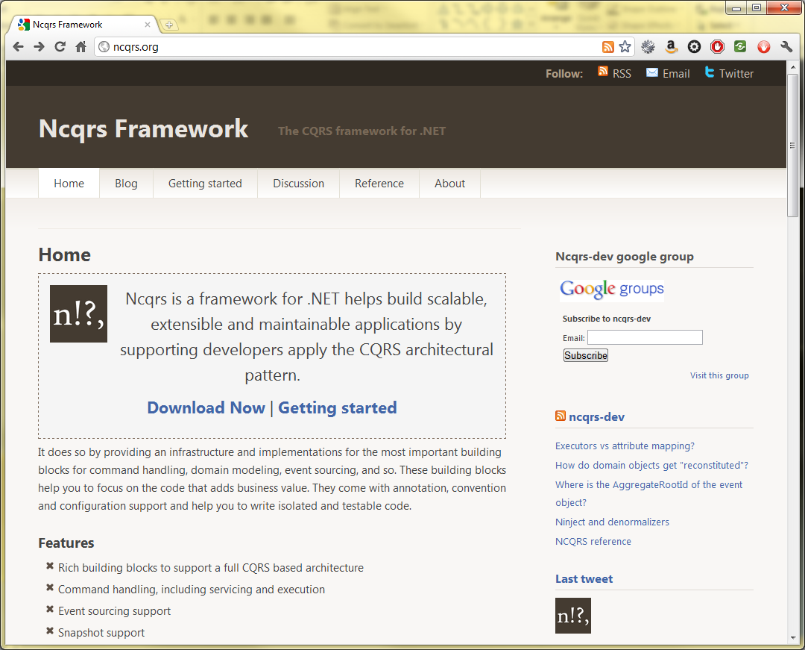
NCQRS

Slide 17
NCQRS
“Ncqrs is a framework for .NET helps build scalable, extensible and maintainable applications by supporting developers apply the CQRS architectural pattern.”

Slide 18
NCQRS
Commands and handlers
Event sourcing / event bus
Domain object lifecycle management
Sample applications
Reference documentation and getting started guide
Google group
Plugins for NServiceBus, SQLite, Azure, StructureMap, RavenDB, MongoDB etc.

Slide 19
Requirements
.NET Framework 3.5+ (some extensions require 4.0)
Microsoft Code Contracts
Ncqrs.dll
CodePlex (outdated)
NuGet (outdated)
Git

Slide 20
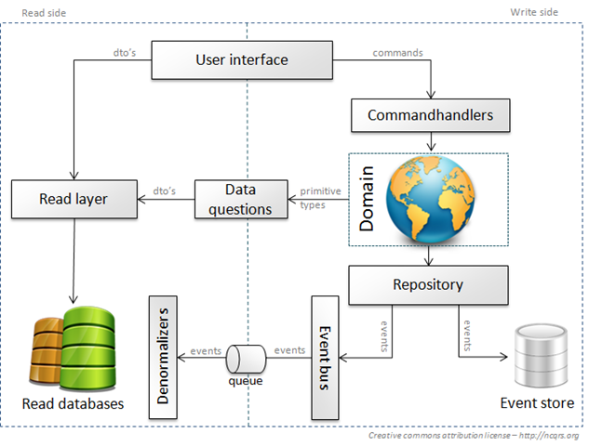
ncqrs.org

Slide 21
Commands
Commands express intent, or what you want the system to do
Commands may contain the same data, but indicate completely different business functions
A last name is corrected because of misspelling
A last name is changed because of marriage
A last name is changed because of divorce

Slide 22
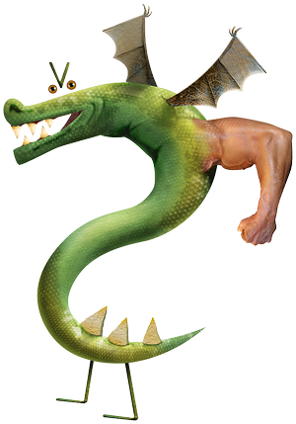
Commands
Command names always begin with a verb – the action to be taken in the domain – and are always in the imperative
PurchaseItemCommand
ProvisionServerCommand
BurninatePeasantsCommand
http://bit.ly/5UJc9Z

Slide 23
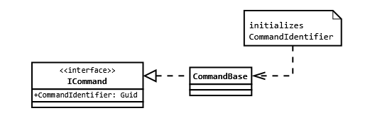
Commands
A command always has a unique identifier
Aggregate root IDs should be included in the commands that relate to them

Slide 24
Commands
Commands will contain any data that is necessary to fulfill the command
Commands contain no business logic

Slide 25
Command Service
Execute() method called to begin the commanding process for a given command
Responsible for routing commands to the appropriate executors
Implements ICommandService
In MVC or WCF, passed as a constructor argument to controllers/services, respectively

Slide 26
ncqrs.org

Slide 27
Command Executors
Do not contain business logic
Call methods on aggregate roots (domain objects), passing them command data
Can retrieve a domain object from the repository (to update it) via a context object
Must call Accept() on the context object to finalize domain changes and write them to the event store (repository)

Slide 28
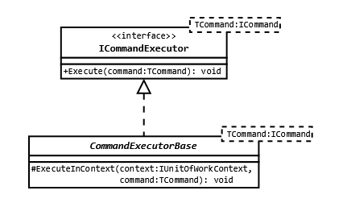
Command Executors

Slide 29
Domain Objects
Domain model follows DDD principles
Domain objects are divided into two classes
Aggregate roots
Value objects
Command executors make changes to, and persist, aggregate roots
Aggregate roots are responsible for their own business logic

Slide 30
Domain Objects
Aggregate roots each have a unique ID
They contain methods that manipulate their state
Domain objects do not posses getters or setters—all state data is private

Slide 31
Domain Objects
Domain objects implement methods that will accept events from the event bus for commands that are completed
Domain objects inherit from either:
AggregateRootMappedByConvention
AggregateRootMappedWithAttributes
These determine how event-handling methods are set up within a domain object

Slide 32
Domain Objects
When an aggregate root is reconstituted, all events are replayed through it, in order, to create the “current state” of that object
Snapshots can be used to mark places in event history where an aggregate root was in a “known good state”, requiring that only events after that point need be replayed to reconstitute the object

Slide 33
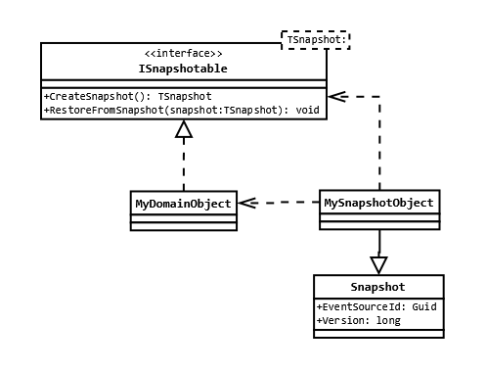
Domain Objects

Slide 34
Domain Objects
EventSourceId and Version properties of the snapshot should always be set to the ID and version of the aggregate root when the snapshot is created.

Slide 35
Repository
Used to save and retrieve aggregate roots
Saving an aggregate root involves storing all of its unpersisted events in the event store
Getting an aggregate root involves reconstituting it by replaying all stored events that relate to it

Slide 36
ncqrs.org

Slide 37
Event Bus
Publishes events to registered event listeners so they can react accordingly
Events can be published:
Synchronously (execution is blocked until all subscribers have handled the event)
Asynchronously (results in “eventual consistency” of read model data)

Slide 38
Event Handlers
Read published events from the event bus, and perform some action based on the event
Commonly used to update the read model via denormalizers
Can be used to issue additional commands, talk to external systems, etc.

Slide 39
Event Store
The event store contains all event data from the application
It is separate from the “read model” data store
It may be cached in memory for better performance

Slide 40
ncqrs.org

Slide 41
Denormalizers
Special event handlers that add event data to the read model data store for the system to consume
Can handle multiple events

Slide 42
Read Model
A data store that is optimized for querying
Data is denormalized into “views” that correspond to the way users will consume data at the UI
Need not be a relational database—could be a document store, for example

Slide 43
ncqrs.org

Slide 44
{}

Slide 45
NCQRS Resources
http://ncqrs.org
http://groups.google.com/group/ncqrs-dev
http://ncqrs.org/reference/
http://ncqrs.org/getting-started/
https://github.com/ncqrs/ncqrs
@ncqrs
Pieter Joost - @pjvds

Slide 46
CQRS/ES Resources
http://cqrsinfo.com/
http://martinfowler.com/bliki/CQRS.html
https://github.com/tyronegroves/SimpleCQRS
Greg Young - @gregyoung
Udi Dahan - @UdiDahan
Darren Cauthon - @darrencauthon

